Slide 1
[Document Title]
NOTICE
The information contained in this document is not to be used for any purpose other than the purposes for which this document is furnished by GENPACT, nor is this document (in whole or in part) to be reproduced or furnished to third parties or made public without the prior express written permission of GENPACT.
Version Control
Version No. | Date | Type of Changes | Owner/ Author | Date of Review/Expiry

Slide 2
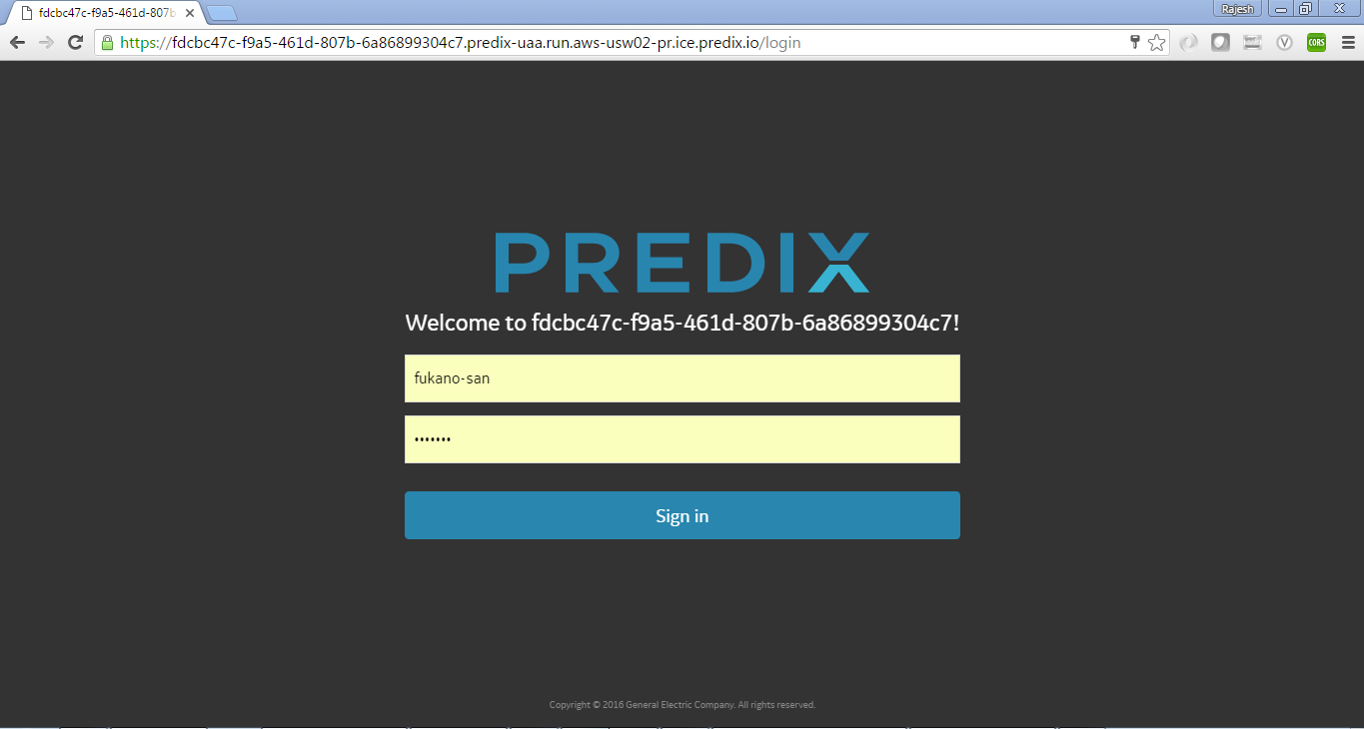
https://komatsu-machine-analysis.run.aws-usw02-pr.ice.predix.io
Enter id – fukano-san
Enter pwd – demo123
Click Sign In

Slide 3
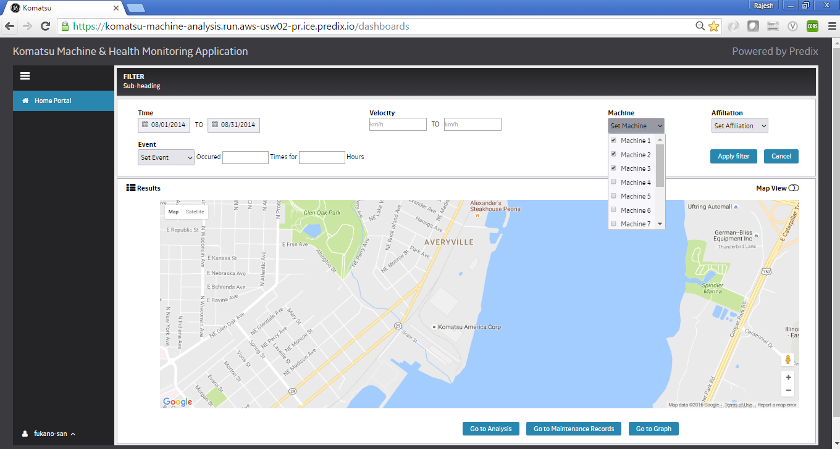
Select Time as 08/01/2014 – 08/31/3014
Select Machine – Machine 1 , Machine 2 , Machine 3
Click Apply Filter

Slide 4
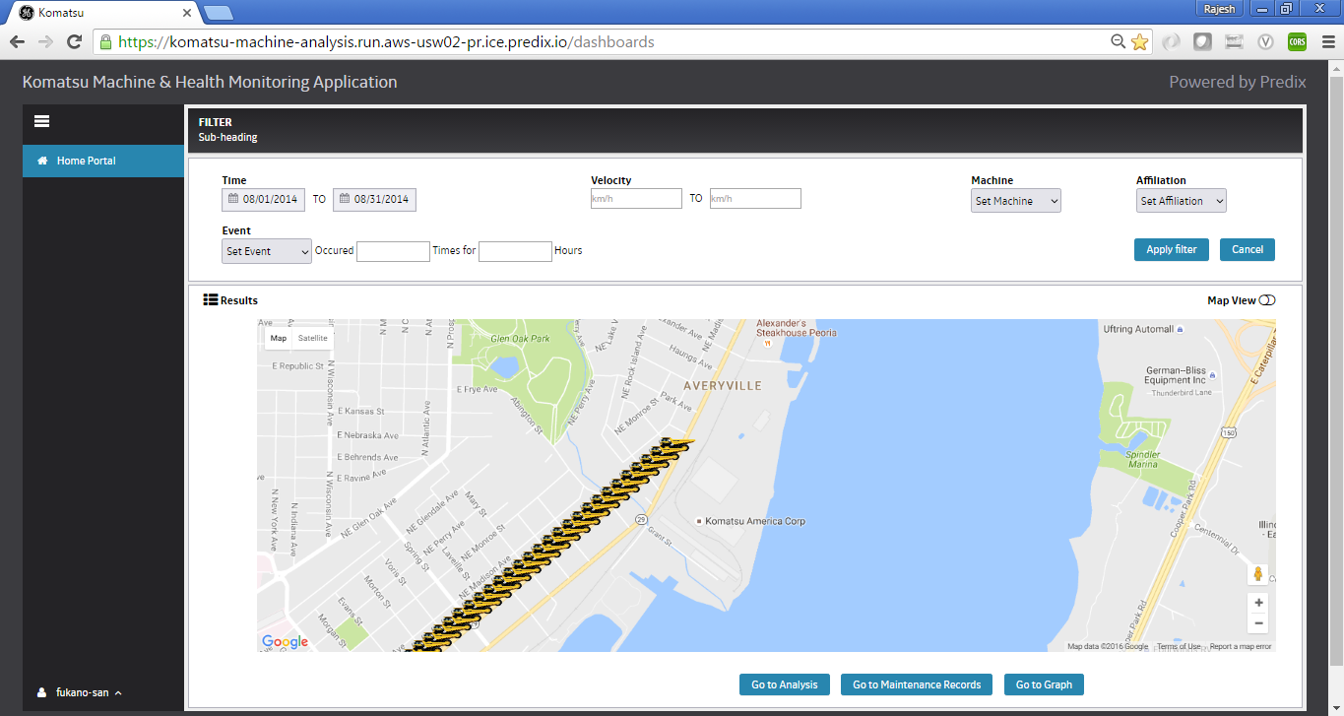
Map plots the coordinates in the map where machine was located during the search period
Click to toggle between Map View and Data View

Slide 5
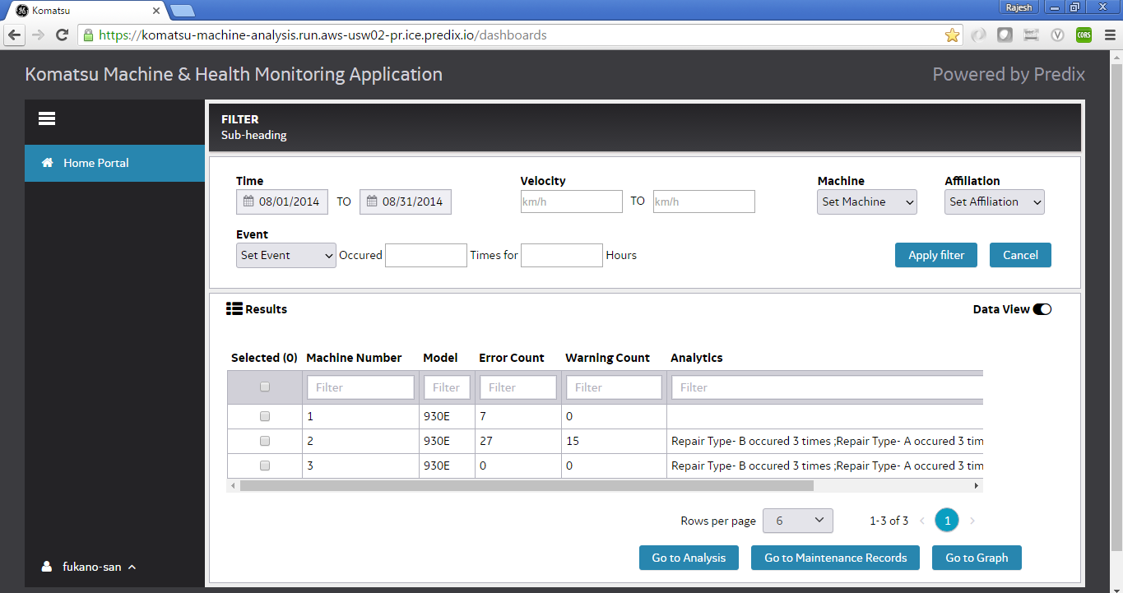
Click to Go to Graph
Data View : Shows the result of the search

Slide 6
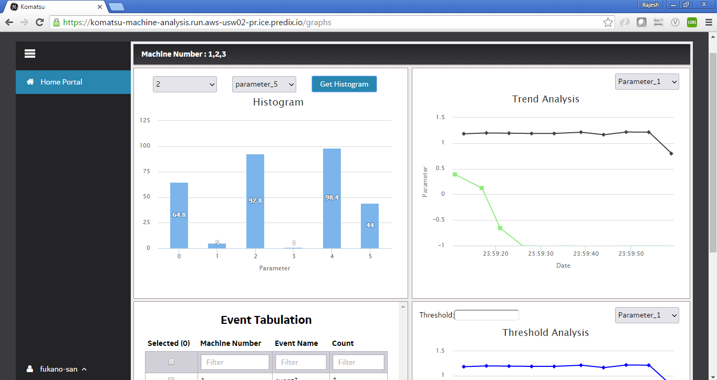
Select Machine
Select Sensor Name
Click
Shows number of occurrence of sensor parameter

Slide 7

Select sensor name
Trend of sensor for selected machine
Machine 1 Data not in system hence no trend for machine 1

Slide 8
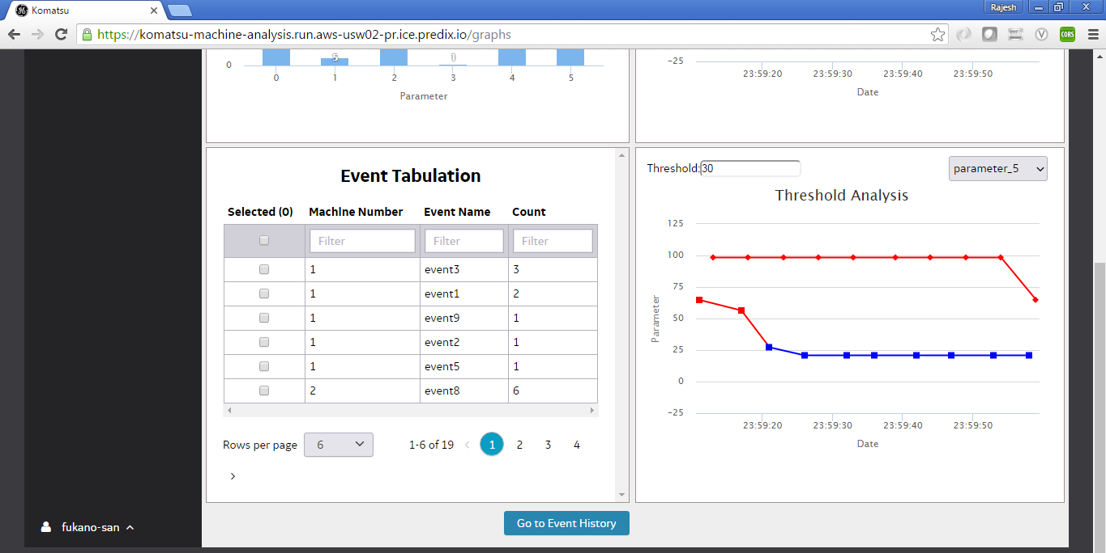
Enter Threshold value
Select parameter value
Event list for selected machines
Select event and click on Go to Event History
Sensor parameter above threshold value will be plotted in red color

Slide 9
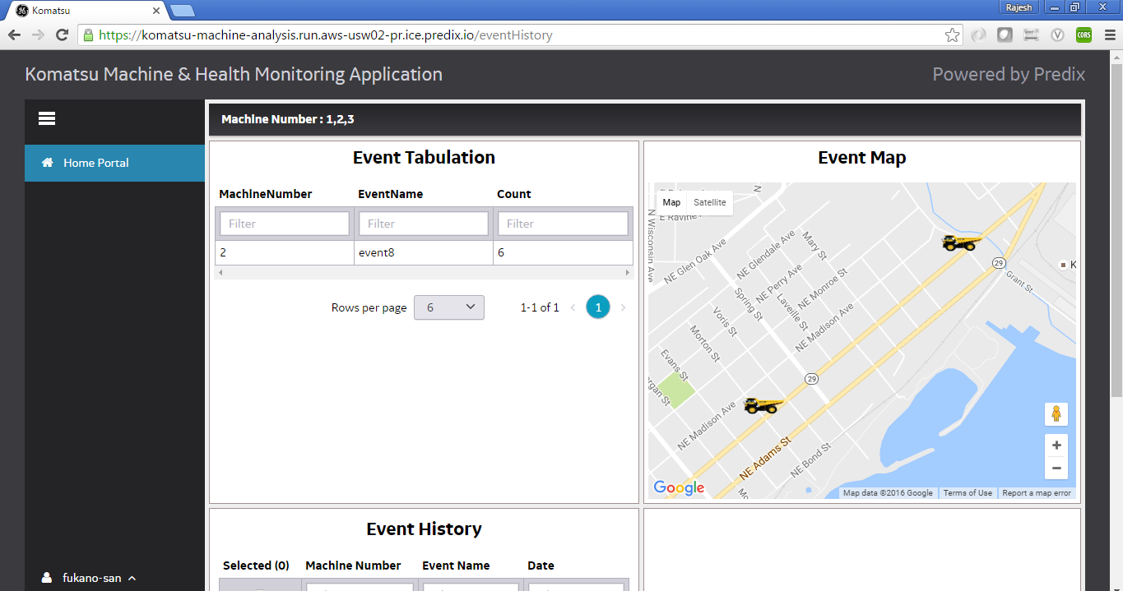
Map showing icon where machine was located when event occurred
Selected event count

Slide 10
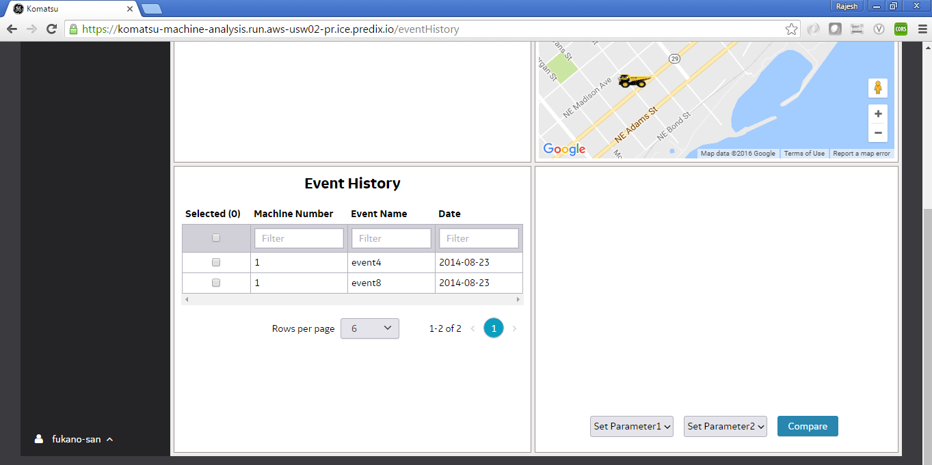
Event history for the selected event

Slide 11
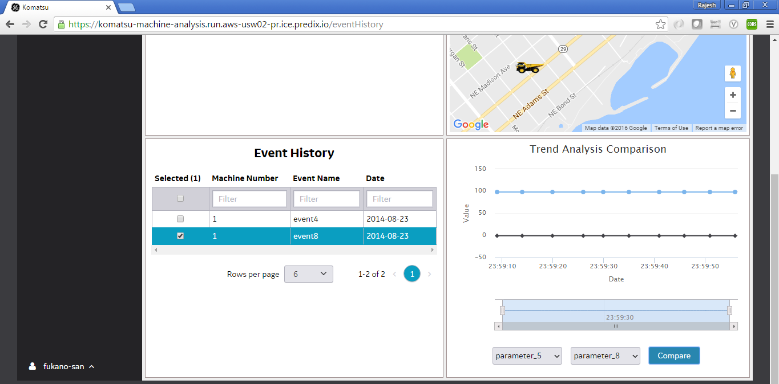
Select event
Choose 2 sensor names and click on Compare

Slide 12
Perform Search Operation
Click on Go to Maintenance records after result is displayed

Slide 13
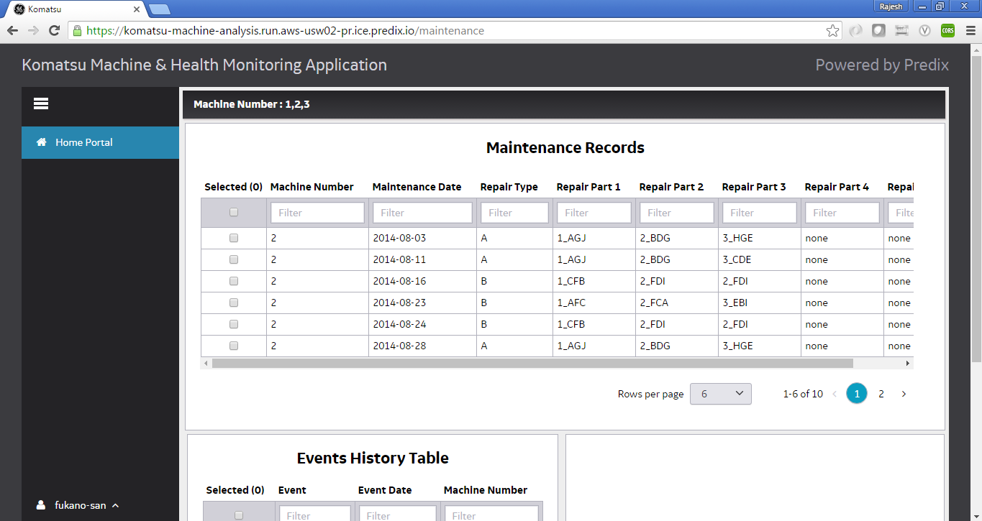
Maintenance records for selected time period

Slide 14
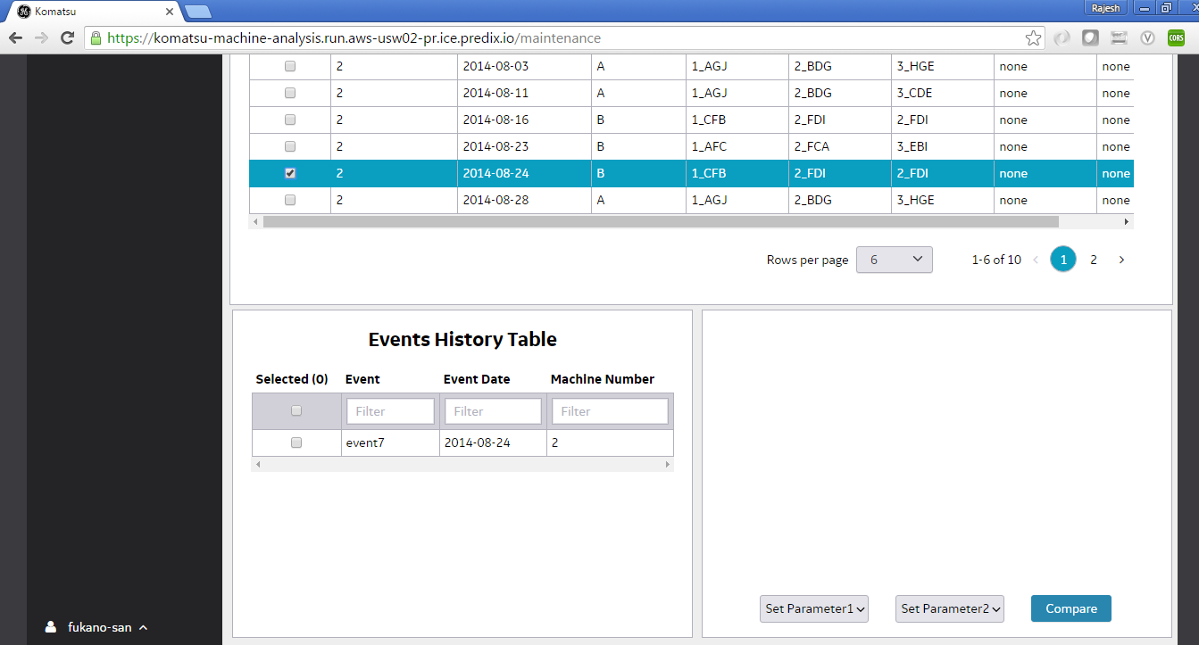
Select event to see Event History below

Slide 15
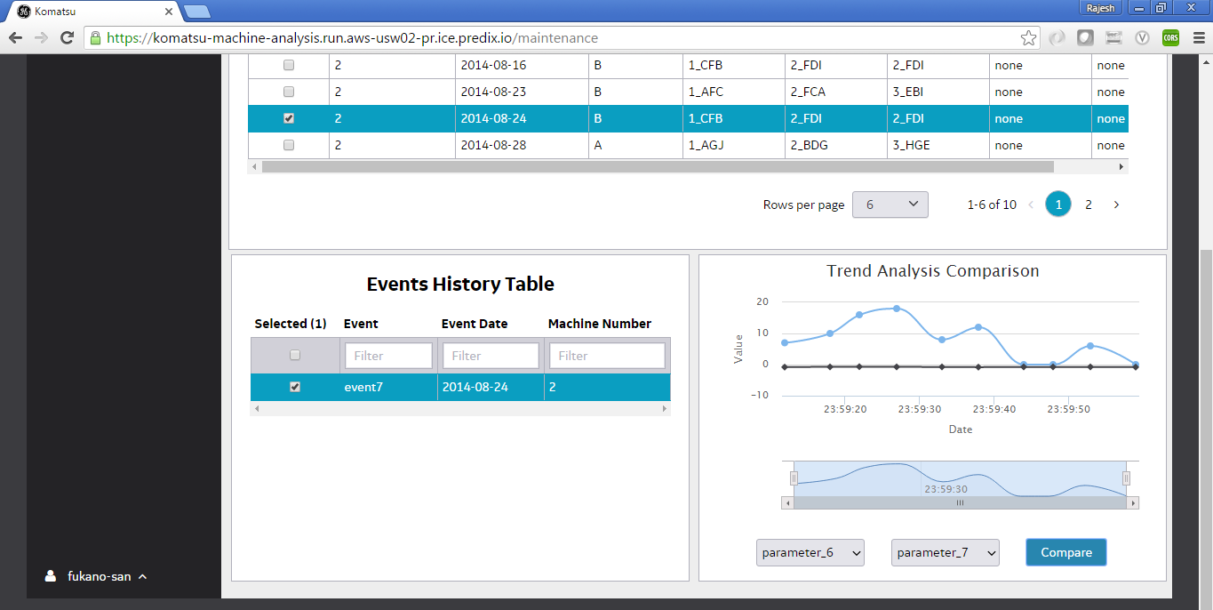
Select row to see the sensor trend during that time
Select 2 parameters and click on Compare

Slide 16
Perform Search Operation
Click on Go to Analysis after result is displayed

Slide 17
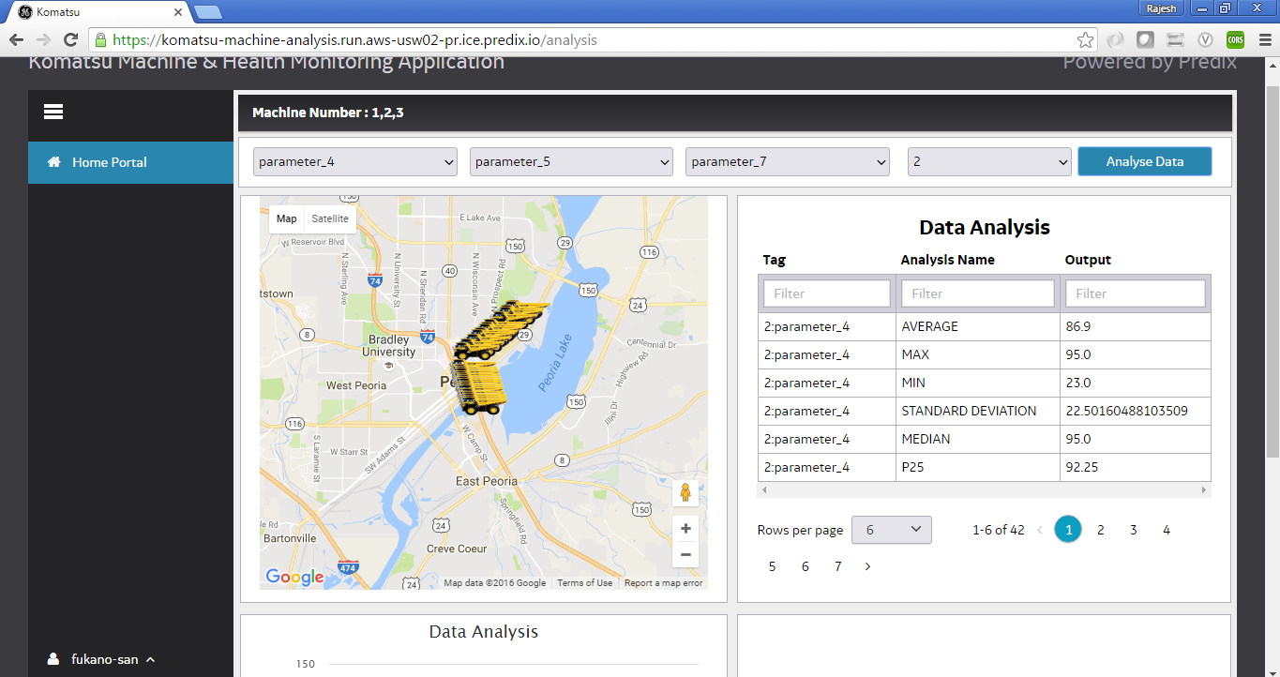
Choose parameter , machine name and click on Analyze Data
Shows vehicles and event types for selected period
Statistical Data

Slide 18
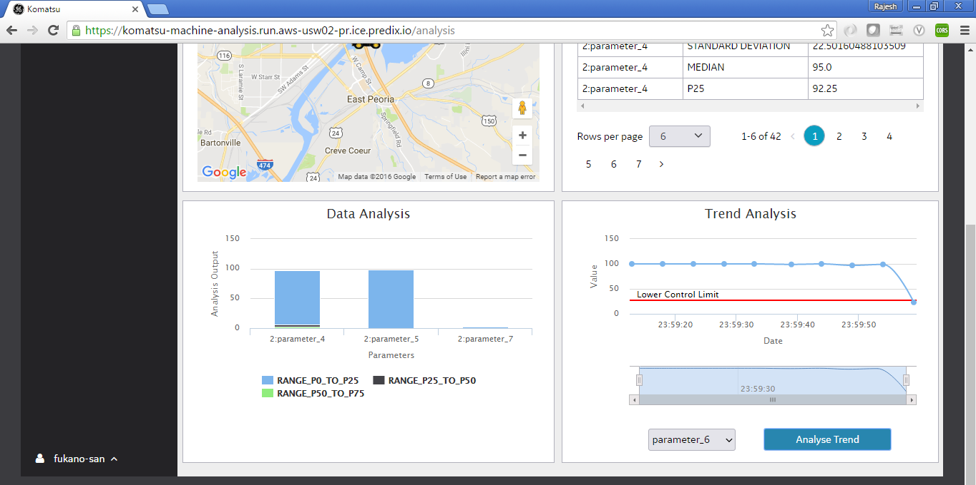
Choose Parameter from below drop down and click on Analyze Trend
Graph shows auto calculated Lower Control Limit
Percentile Details

Slide 19
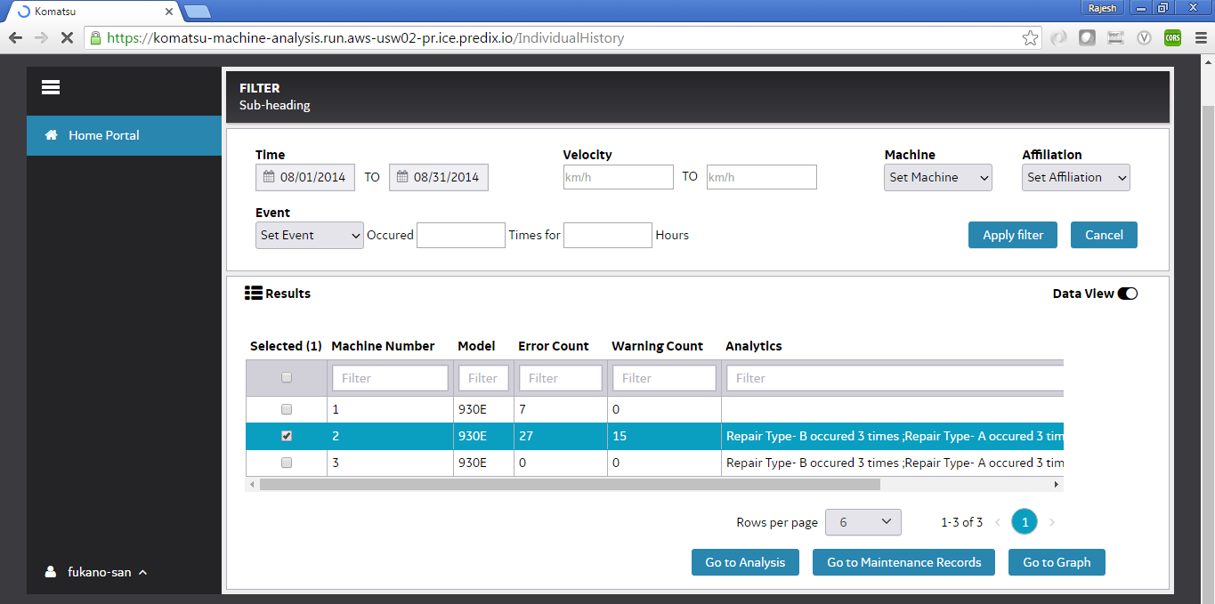
Perform Search Operation from Home page
Click on the row to go to Individual History

Slide 20
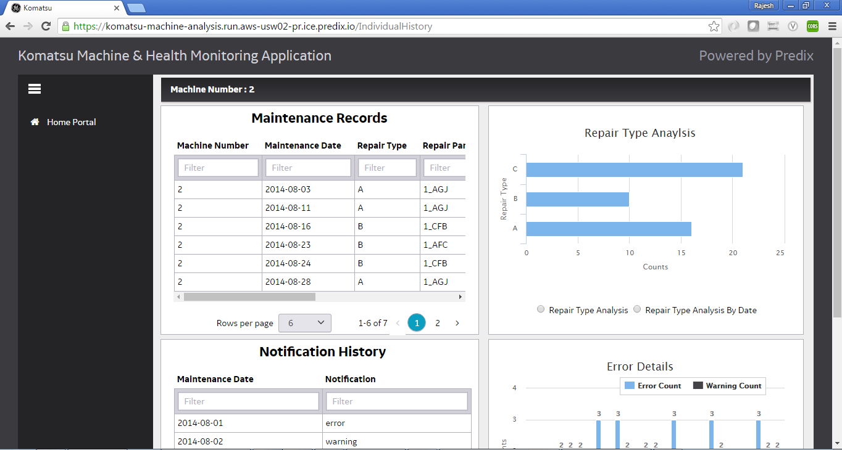
Maintenance record for selected machine
Repair Type Analysis View

Slide 21
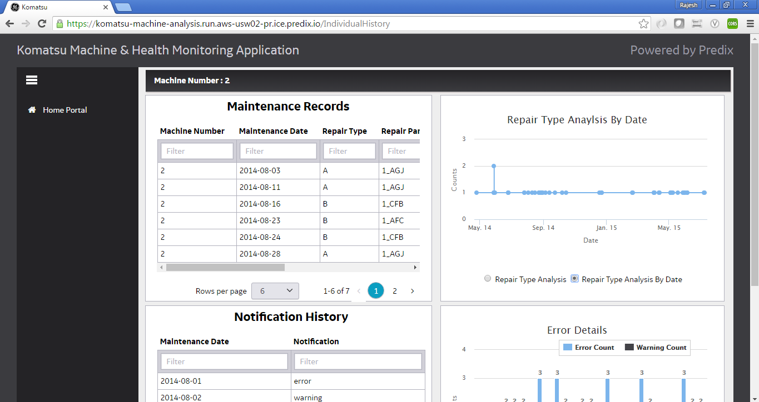
Repair Type Analysis View by date

Slide 22
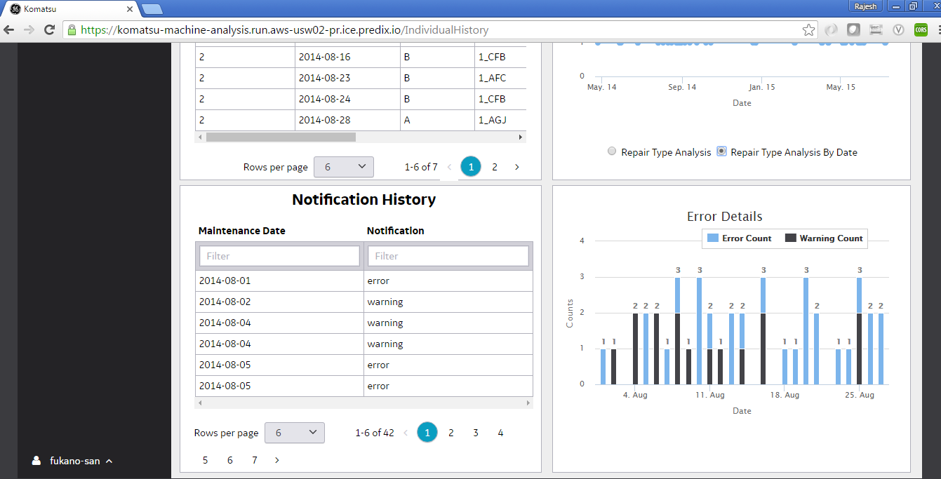
Notification History for selected machine
Error & Warning Count for selected time

Slide 23
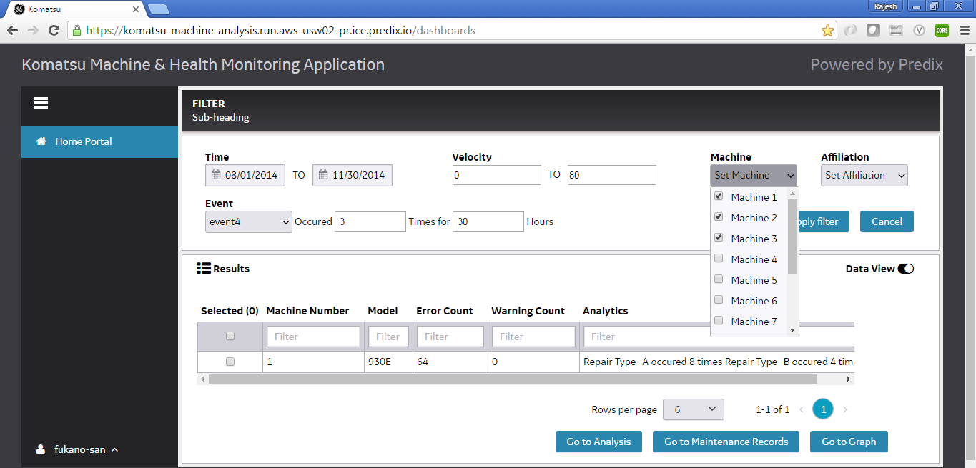
From Home page search for Start Date : -08/01/2014 and End Date : 11/30/2014
Velocity :0 to 80
Machine :- 1 m 2m 3
Affiliation :- Mountain A, Mountain B
Event : event4 occurred 3 times for 30 hours
Click Apply Filter

Slide 24
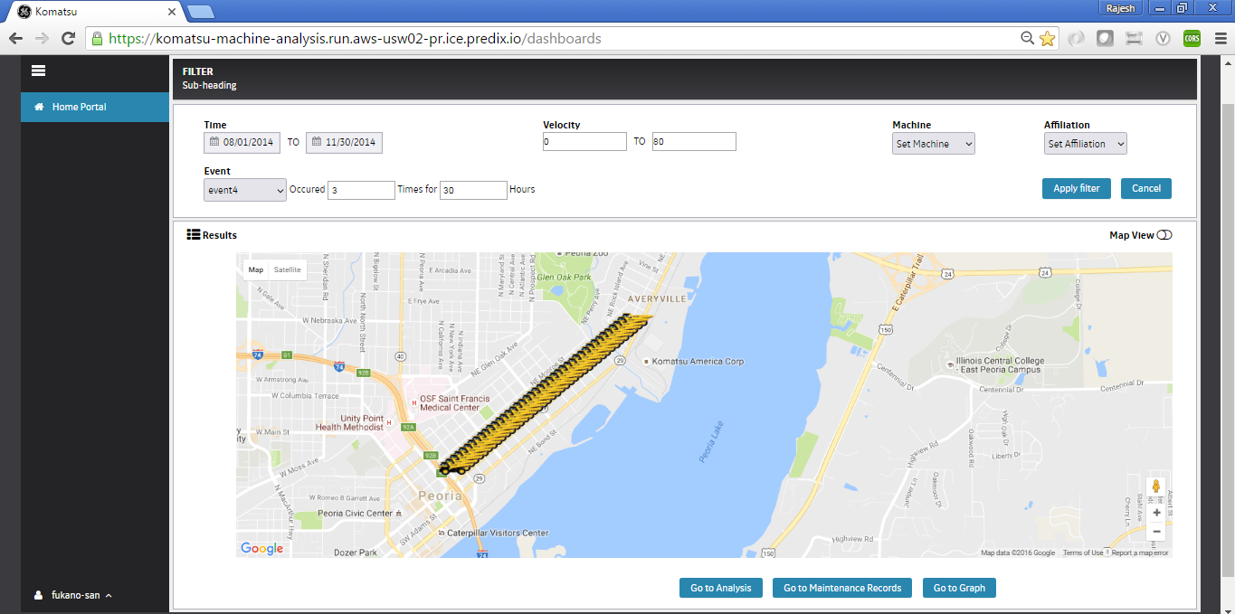
Search Results

Slide 25
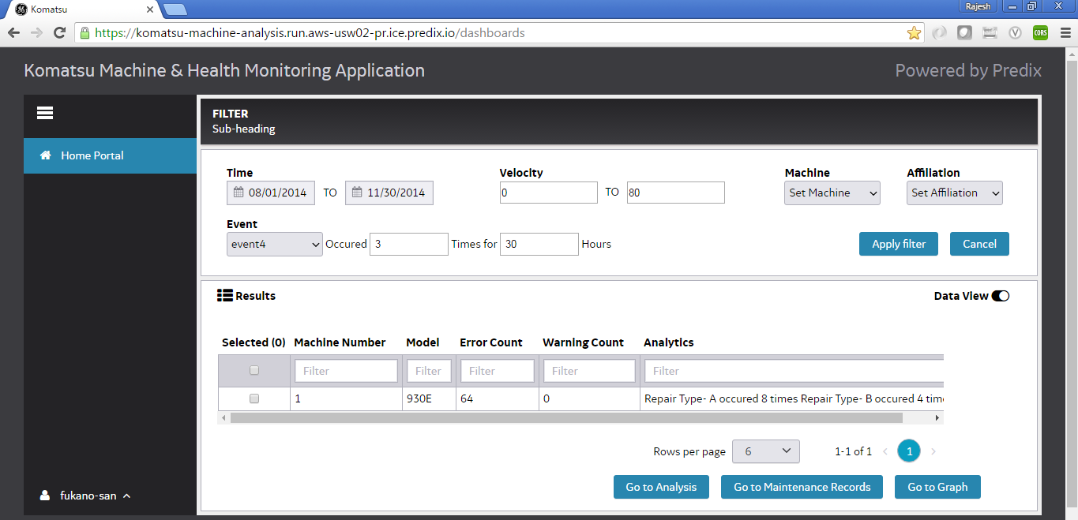
Data view

